Slide 1



superstore_stores Analysis report
View in Power BI

Slide 2
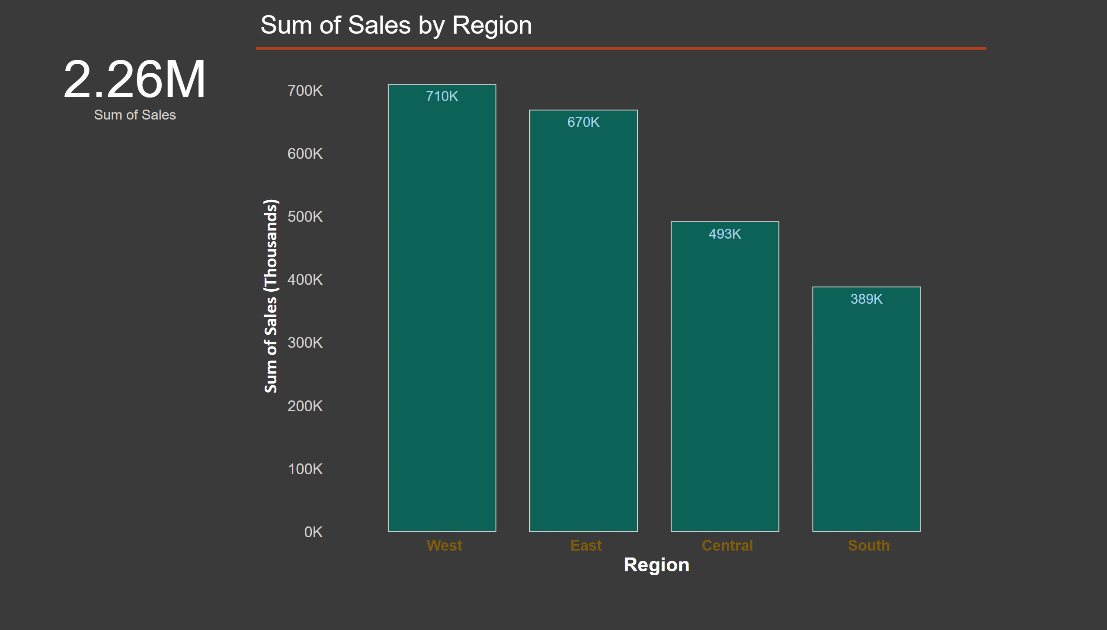
Page 1
Notes:
card
No alt text provided
clusteredColumnChart
No alt text provided

Slide 3
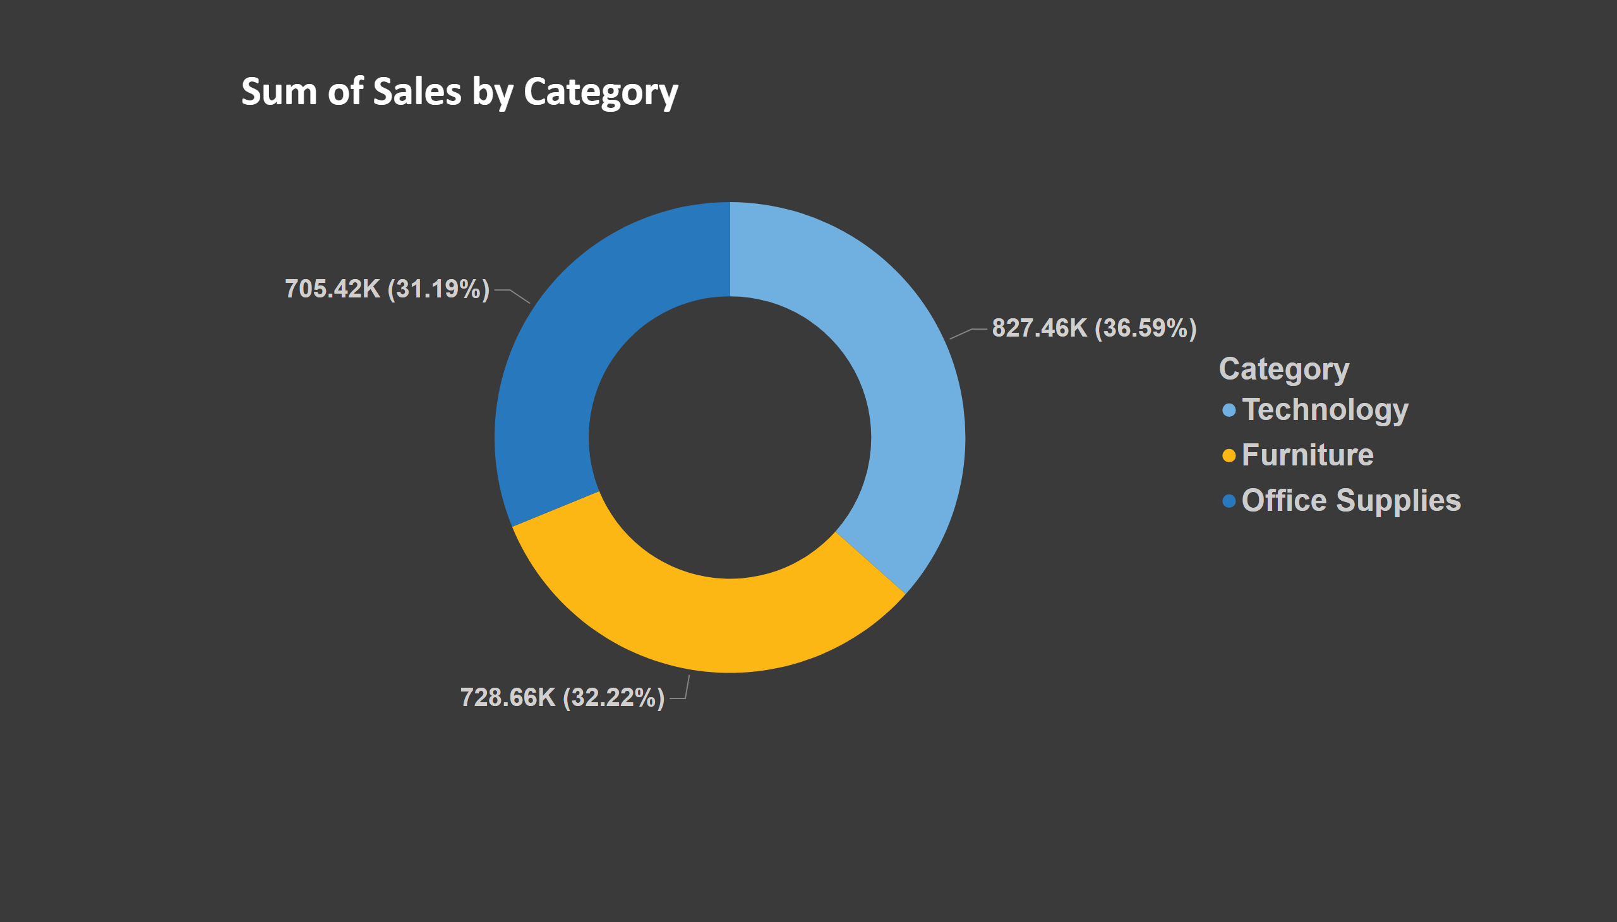
Page 3
Notes:
donutChart
No alt text provided

Slide 4
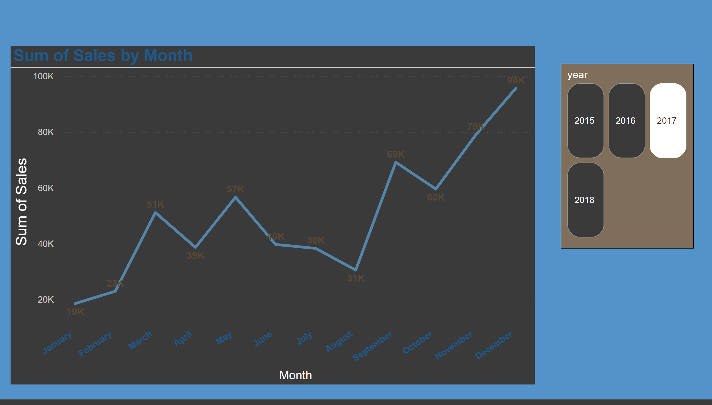
Page 2
Notes:
advancedSlicerVisual
No alt text provided
lineChart
No alt text provided

Slide 5
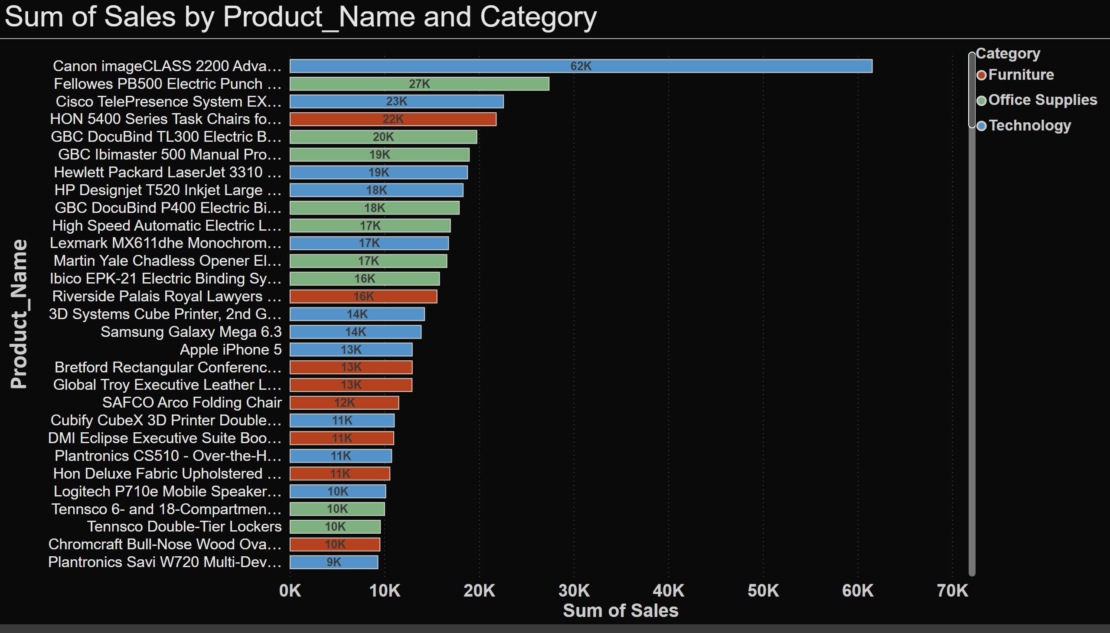
Page 4
Notes:
barChart
No alt text provided

Slide 6
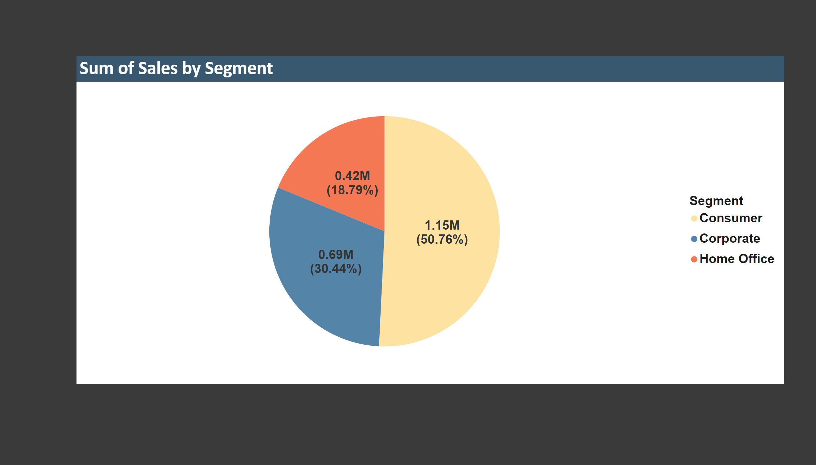
Page 5
Notes:
pieChart
No alt text provided

Slide 7
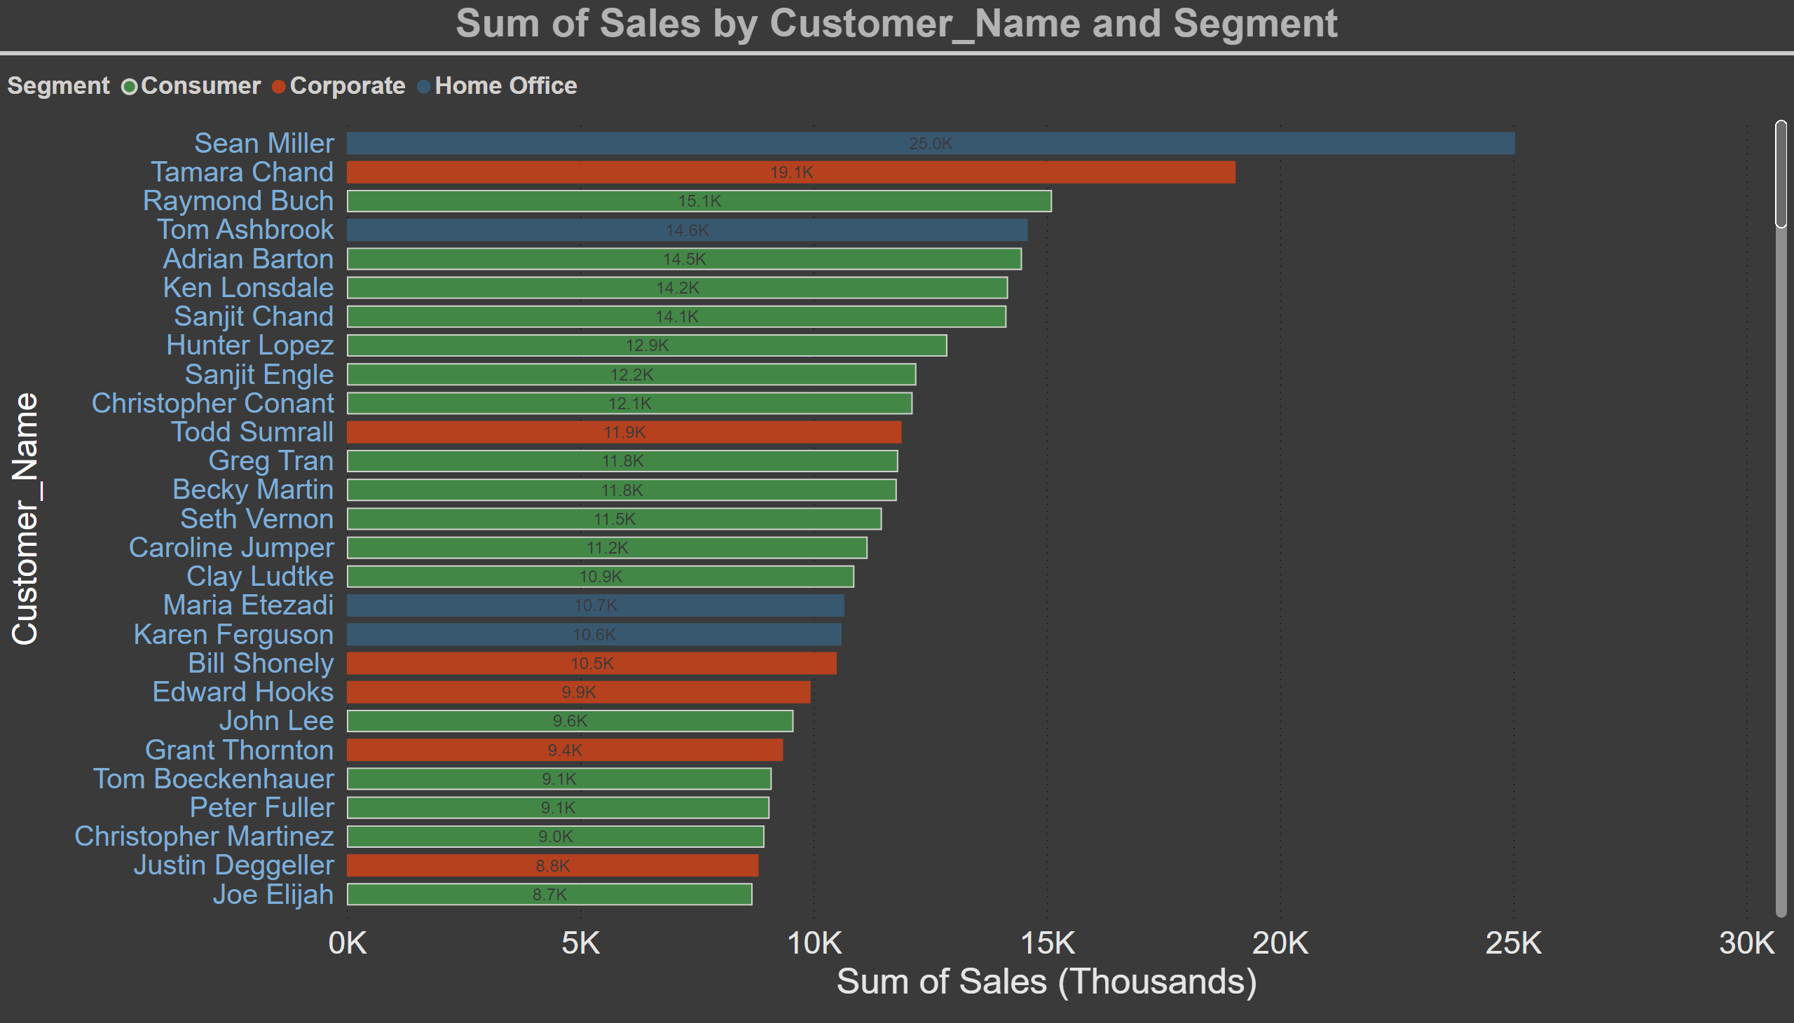
Page 6
Notes:
barChart
No alt text provided

Slide 8
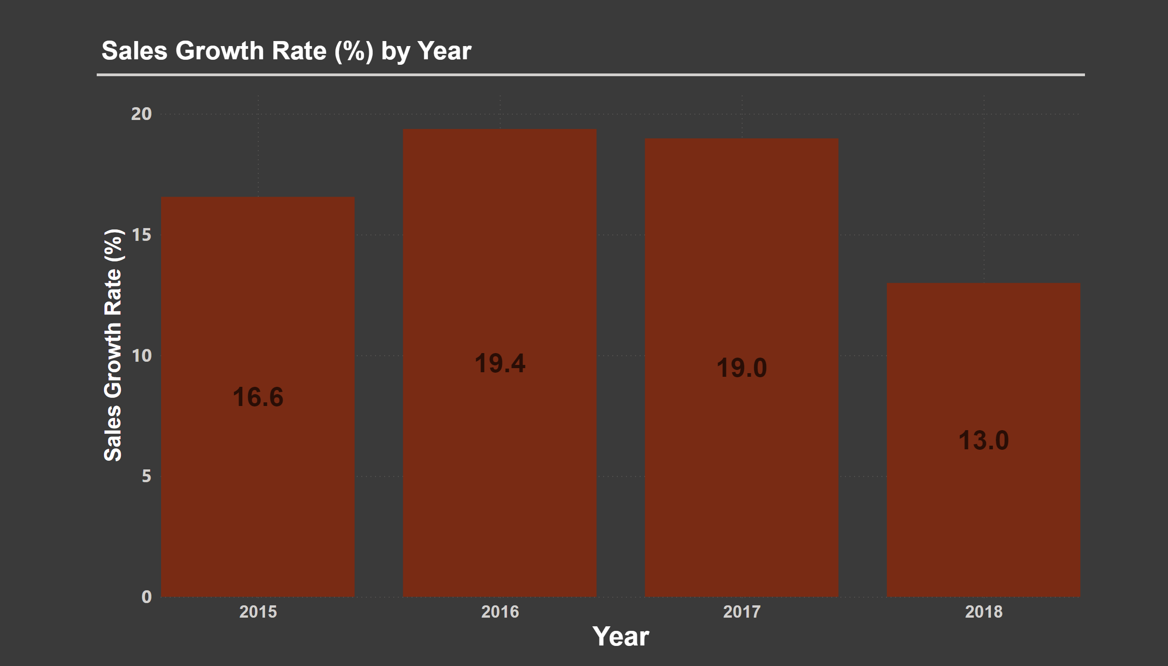
Page 7
Notes:
clusteredColumnChart
No alt text provided

